Slide 1
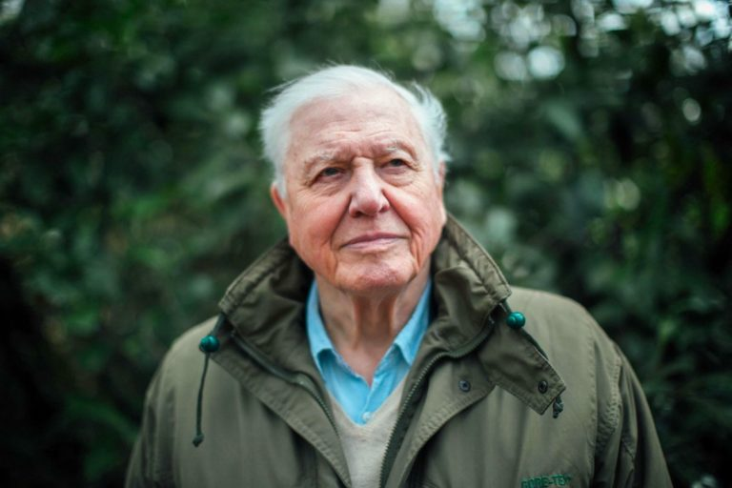
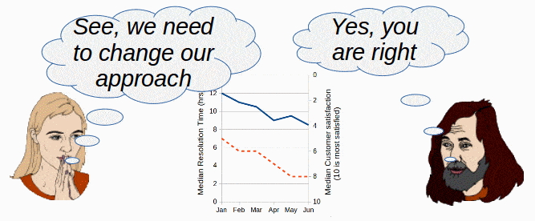
Persuasive Text:
David Attenborough

Slide 2
A persuasive text is a written or spoken piece of communication. Its purpose is to persuade or convince the reader to take a particular action or to adopt a particular point of view.

Slide 3
Language Features of Persuasive Text
personal,
Strong and emotional words
sense of urgency
empowering,
Inspiring and motivating
Repetition
Confident tone
call to action
Notes:
Find these language features in the next few slides

Slide 4
STAGE 1: INTRODUCTION
Your excellencies, delegates, ladies and gentlemen,
as you spend the next two weeks, debating, negotiating,
persuading and compromising, as you surely must, it’s
easy to forget that ultimately the emergency climate
comes down to a single number, the concentration of
carbon in our atmosphere.
Personal
Personal , strong words
Sense of urgency
State the issue

Slide 5
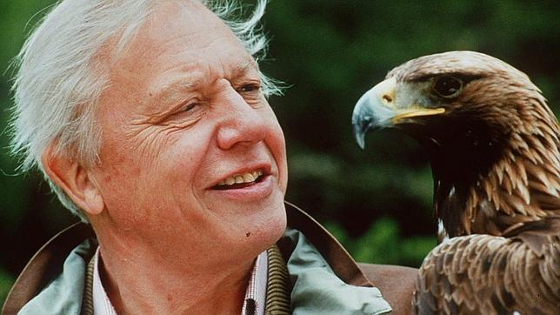
STAGE 1: INTRODUCTION (Cont.)
The measure that greatly determines global temperature
and the changes in that one number is the clearest way to
chart our own story,
for it defines our relationship with our world.
State the issue
Personal
Personal , strong words

Slide 6
STAGE 2: Body: Build your persuasive argument with facts
... just over 10,000 years ago, that number suddenly stabilized and with it, Earth’s climate.
We found ourselves in an unusually benign period with predictable seasons and reliable weather. For the first time civilization was possible and we wasted no time in taking advantage of that.
Everything we’ve achieved in the last 10,000 years was enabled by the stability during this time.

Slide 7
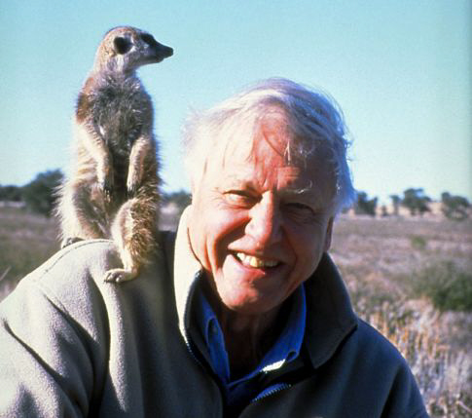
STAGE 2: Body (Cont.)
Personal and repetition
Our burning of fossil fuels, our destruction of
nature, our approach to industry, construction and
learning, are releasing carbon into the atmosphere
at an unprecedented pace and scale.
Sense of urgency

Slide 8
STAGE 2: Body (Cont.)
Rhetorical question
Is this how our story is due to end? Perhaps the fact
that the people most affected by climate change are
no longer some imagined future generation, but
young people alive today, perhaps that will give us
the impetus we need to rewrite our story, to turn
this tragedy into a triumph. We are after all, the
greatest problem solvers to have ever existed on
Earth.
Sense of urgency
personal
Confident, positive

Slide 9
STAGE 3: CONCLUSION
An emotional appeal with strong, heartfelt words. Inspiring and motivating.
Emotional,personal
In my lifetime, I’ve witnessed a
terrible decline.
In yours, you could and should witness a
wonderful recovery.
That desperate hope, ladies and gentlemen, delegates,
excellencies, is why the world is looking to you and why you are here. Thank you.
modality
Recaps the Purpose and positive consequences
A call to action, empowering

Slide 10
What text is this?
persuasive
Personal, emotional, sense of urgency, empowering, inspiring, motivating, call to action.
What language features of persuasive text did we find?
Facts, examples information
What made this text even stronger?

Slide 11
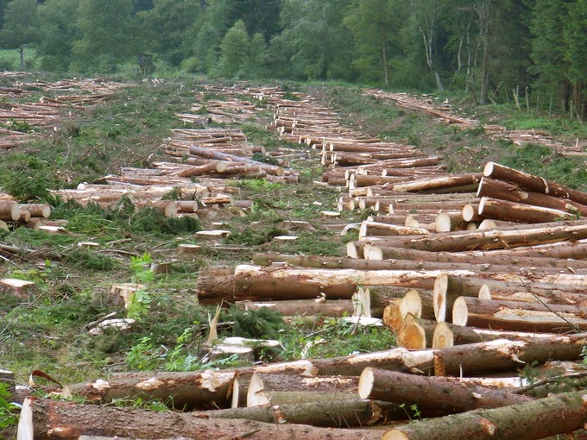
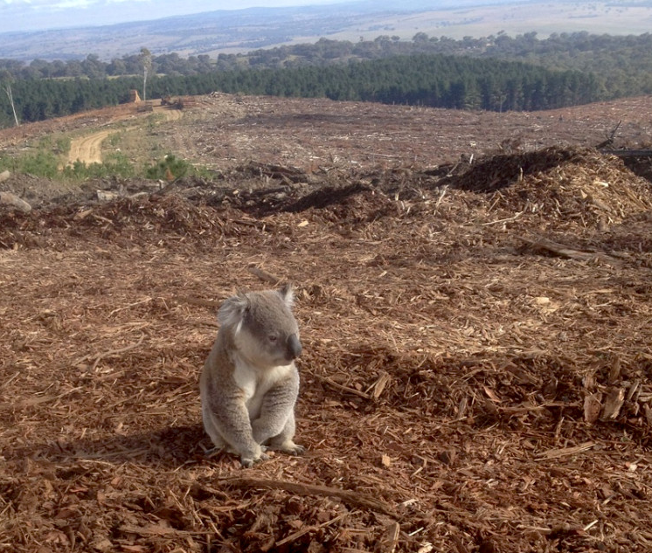
Stages and Phases of Persuasive Text
A PERSUASIVE TEXT CAN TAKE THE FORM OF A LETTER, SPEECH, BROCHURE, ADVERTISEMENT, POSTER ... AND MORE

Slide 12
Stage 1: Introduction - Engage the Reader
Phase
Background Information
Everything we’ve
achieved in the last
10,000 years was enabled
by the stability during this
time.
Phase
Present the argument and Introduce the purpose.
The measure that greatly determines global temperature
and the changes in that one number is the clearest way to chart our own story, for it defines our relationship with our world.
Grab their attention!
Clearly state the purpose
Present with knowledge and confidence
Phase
Clear Statement of purpose ..... the emergency climate comes down to a single number, the concentration of
carbon in our atmosphere.

Slide 13
Stage 2: Body- Present a Strong and Persuasive Case Phases can vary ...
Phase
Supporting evidence:
The writer presents evidence to support their argument. This can include facts, statistics, examples, and expert opinions.
our approach to industry, construction and learning, are releasing carbon into the atmosphereat an unprecedented pace and scale.
Phase Solutions
A new industrial revolution, powered by millions of sustainable innovations, is essential, and is indeed already beginning.
Will the argument convince the audience?
Phase Refutation: Today, those who’ve done the least to cause this problem, are being the hardest hit.
Phase Counterarguments: In this case there are no counter arguments presented. Why?

Slide 14
Stage 3: Conclusion Take Action!
Emotional and personal
Inspire action!
Phase
Repeat the Purpose
In my lifetime, I’ve witnessed a terrible decline.
In yours, you could and should witness a wonderful recovery.
Encourage and inspire the Reader to act!
That desperate hope, ladies and gentlemen, delegates, excellencies, is why the world is looking to you and why you are here.
Strong, positive and convincing

