Slide 1
Texts: Signs and Posters
Their structure, purpose and purpose and stages

Slide 2
signs
Stage 2: Grab their attention! The whole sign must send the message or warning.
Purpose: To communicate a message or warning
Stage 3: Use words - only if necessary. Images will more quickly be seen and understood.
Stage 1: Choose the information: What is the message or warning?
Overall Structure Simple. Easy to read and view as a whole. Bright and colourful to attract attention.

Slide 3
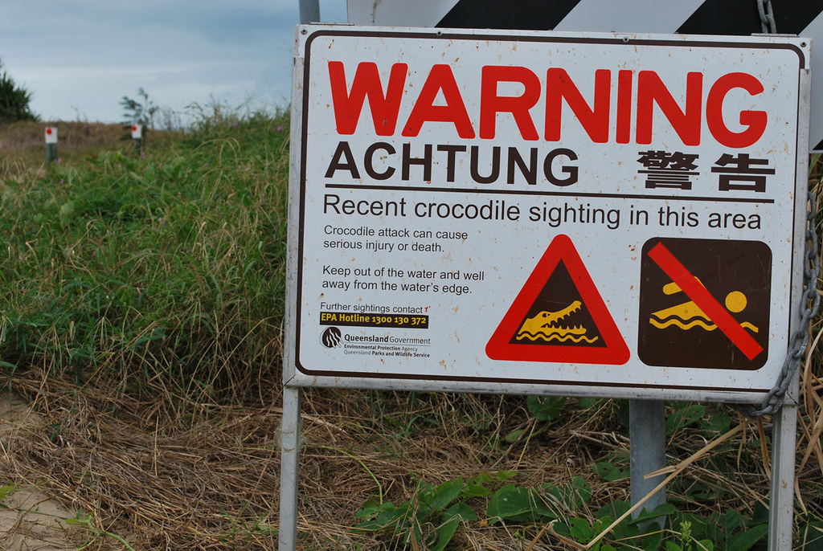
signs
What is the purpose of this sign?
Who is the audience?
Why might the road be closed?
What should the reader do in response to the sign?
What is the purpose of this sign?
Who is the audience?
What should the reader do
in response to the sign?

Slide 4
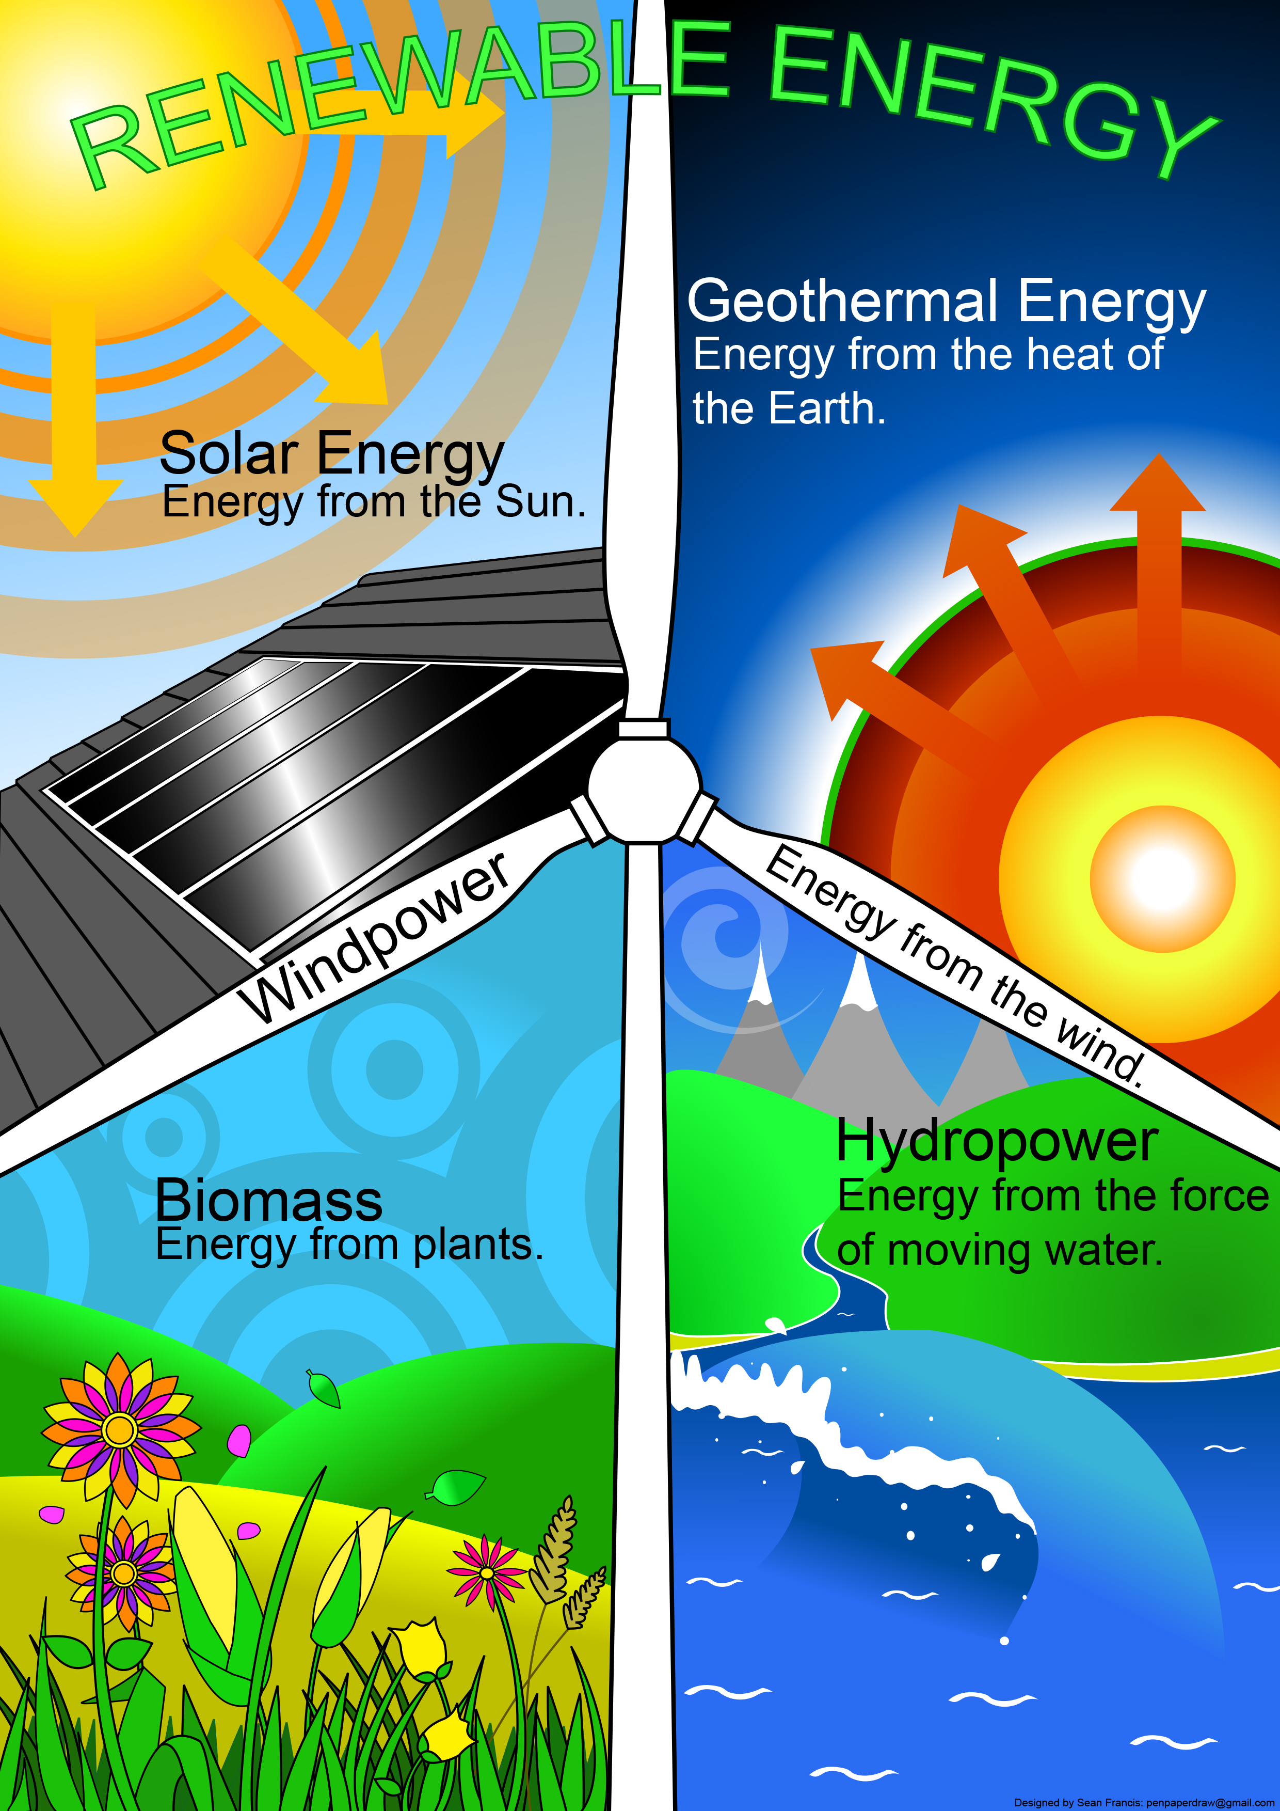
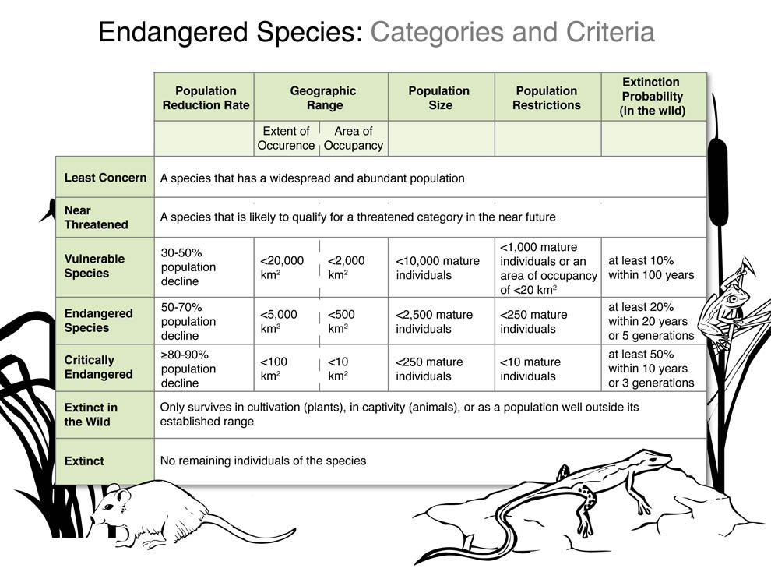
Posters

Slide 5
Advertising POSTERS
Stage 2:Grab their attention! Colour! Shapes! Great images!
Stage 3: Business Logo is easily seen.
Purpose: To sell something
Stage 1: Choose the information: What is it you want to sell?
Stage 4: Use words strategically. The important information is the first you see.
Overall Structure: Not too “busy.” Just enough information. Easy to read and view. Bright and colourful but don’t overdo it.

Slide 6
Advertising POSTERS
Stage 2:Grab their attention! Colour! Shapes! Great images!
Stage 3: Business Logo is easily seen.
Purpose: To sell something
Stage 1:Choose the information: What is it you want to sell?
Stage 4: Use words strategically. The important information is the first you see.
Overall Structure: Not too “busy.” Just enough information. Easy to read and view. Bright and colourful but don’t overdo it.

Slide 7
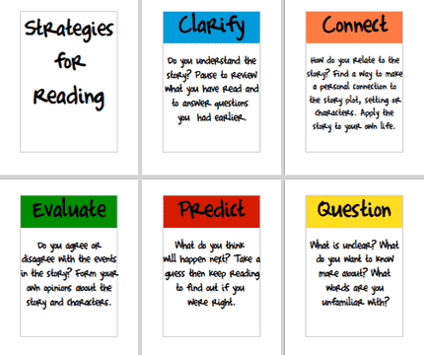
INFORMATIVE PostersI
Stage 2:Use headings. Organise your information under the headings.
Purpose: To give information on a topic.
Stage 3: Use other ways to share the information – diagram, photos, text box, etc.
Stage 1:Choose the information: What is it you want to share?
Stage 4: Use words strategically. Give enough information but not too much.
Overall Structure: You want a structure or graphic organizer that works best with the information. Pictures and other element should be clear and easily seen.

Slide 8
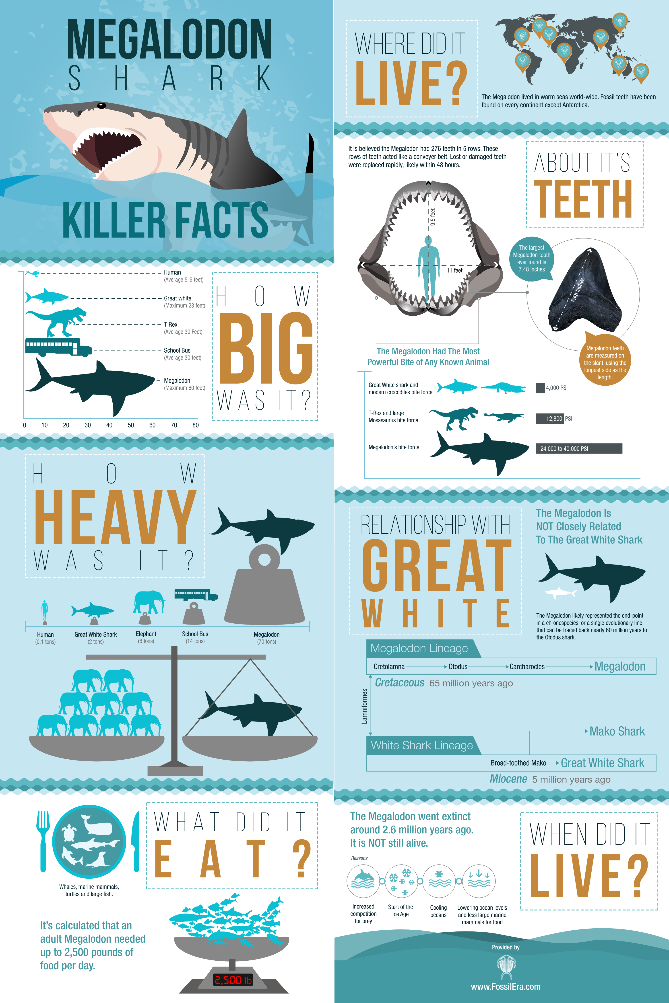
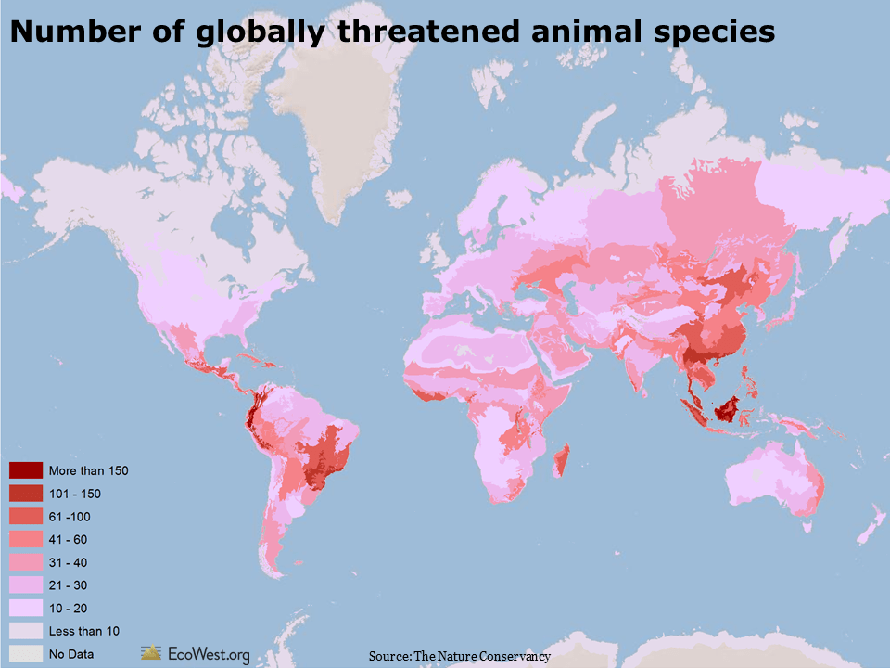
Examples of Informative Posters
Headings, diagrams, tables,
Purpose: To give information on a topic.
How you decide to organise and set out your information is important. Plan your structure carefully.
Use of map and colour key to organise information

Slide 9
POSTERS TO HELP YOU THINK OR FEEL
What message is this poster sending? (purpose)
Is it successful? Why or why not?
Who is the audience?
Where would this poster be displayed?
How would you describe the poster and its message to someone who is blind or has low vision?
Share
I think ...
I feel ...

Slide 10
POSTERS TO HELP YOU THINK OR FEEL
What message is this poster sending? (purpose)
Is it successful? Why or why not?
Share.
I think ...
I feel ....
Who is the audience?
Where might this poster be displayed?
What are some of the strategies that this poster has used to attract your attention?

Slide 11
POSTERS TO HELP YOU THINK OR FEEL
What message is this poster sending? (purpose)
Is it successful? Why or why not?
Share.
I think ...
I feel ....
Who is the audience?
Where might this poster be displayed?
What are some of the strategies that this poster has used to attract your attention?

