Slide 1
Wombats
TEXT TYPES

Slide 2
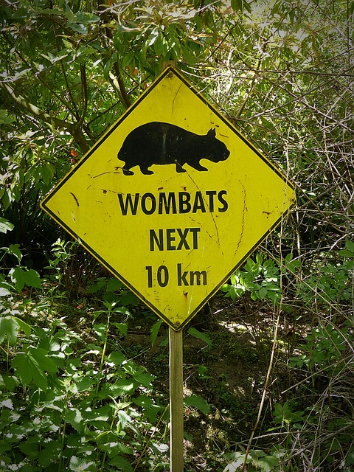
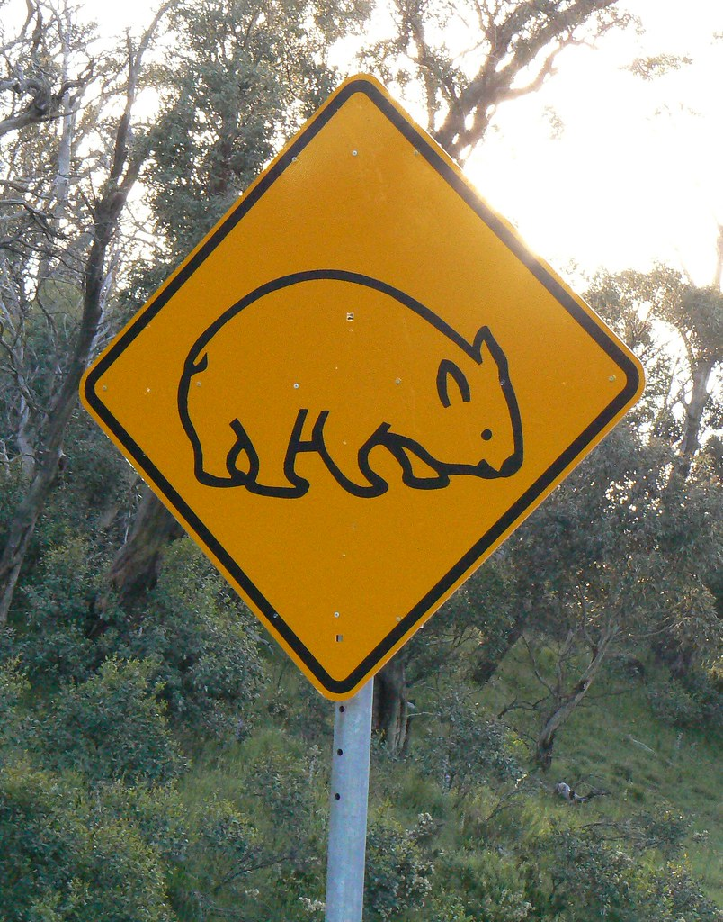
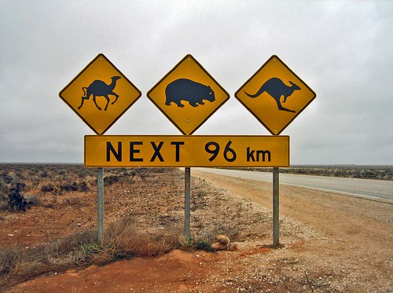
SIGNS INFORMATION TEXTS
This Photo by Unknown Author is licensed under CC BY-SA
Notes:
WHAT DO THESE SIGNS TELL US ....... WHAT IS THEIR PURPOSE?
HOW DO THEY GIVE US INFORMATION? ....... BY THEIR SHAPE, PICTURES, WORDS?

Slide 3
Fact or Opinion?
Opinion
Wombats are the cutest animals in the world. I think they would be amazing to cuddle. A wombat would be softer than my teddy. I want one for a pet but my Mum thinks they would be very messy.
Notes:
ARE THERE ANY FACTS HERE ABOUT WOMBATS?

Slide 4
What is this text type?
Recount
On Saturday my family and I were driving along a country road. Suddenly a wombat came out of the bushes and on to the road. Dad stopped and we watched it cross over to the other side. It waddled off and we drove on to our grandparents’ house.
Notes:
WHAT MAKES THIS TEXT A RECOUNT?

Slide 5
Wombat Stew
Procedure
Recipe
Fill a billy with water and
Place it over a fire to boil.
When boiling add:
mud
emu feathers
flies
slugs and bugs and creepy crawlies
gumnuts
Taste
Throw away. It will be disgusting.
Notes:
WHAT ARE THE CLUES THAT HELP US CHOOSE THE TEXT TYPE?

