Slide 1
The Purpose of Text Types

Slide 2
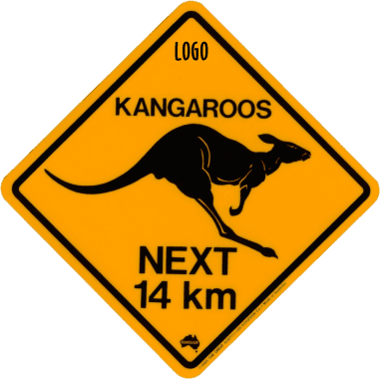
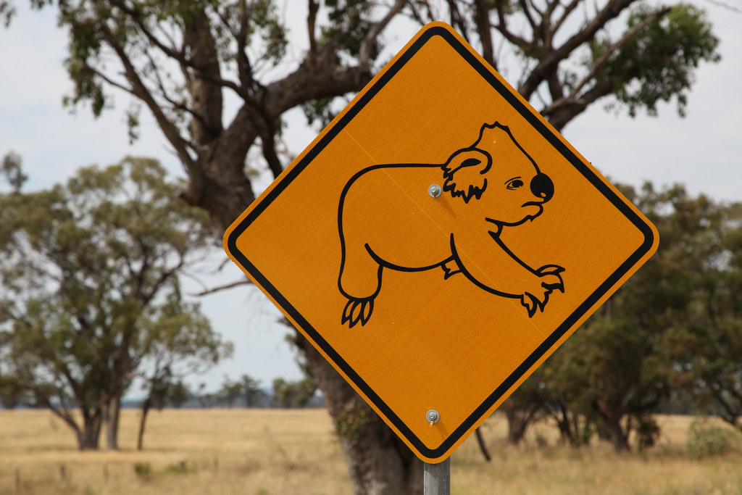
Signs
Signs send a clear message. They might warn, give instructions, or a piece of information, give direction, keep us safe.
Notes:
If you made a sign, what would it be about? ? What is its purpose?

Slide 3
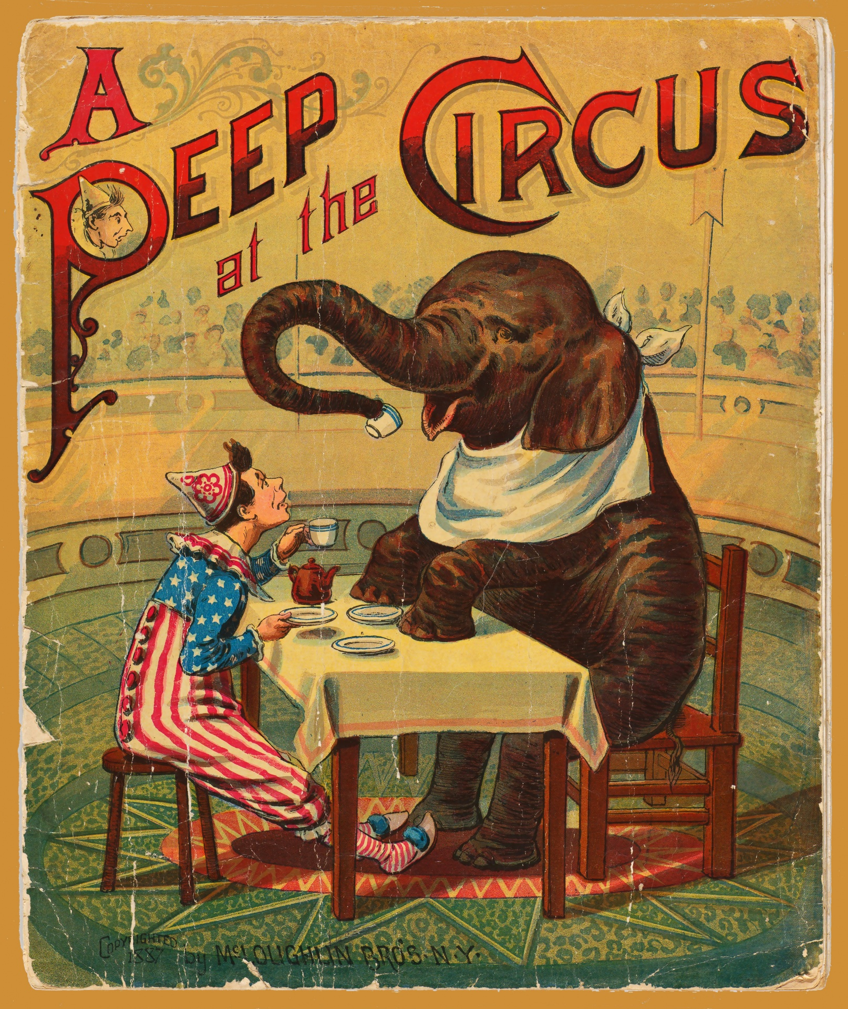
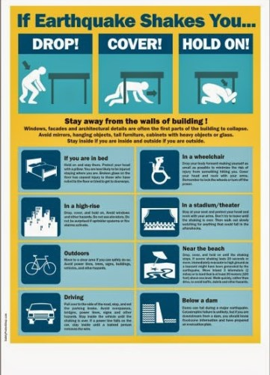
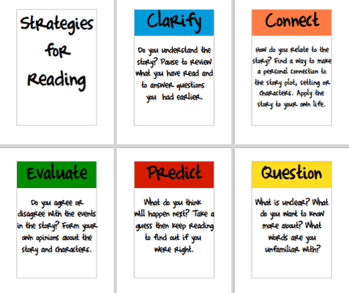
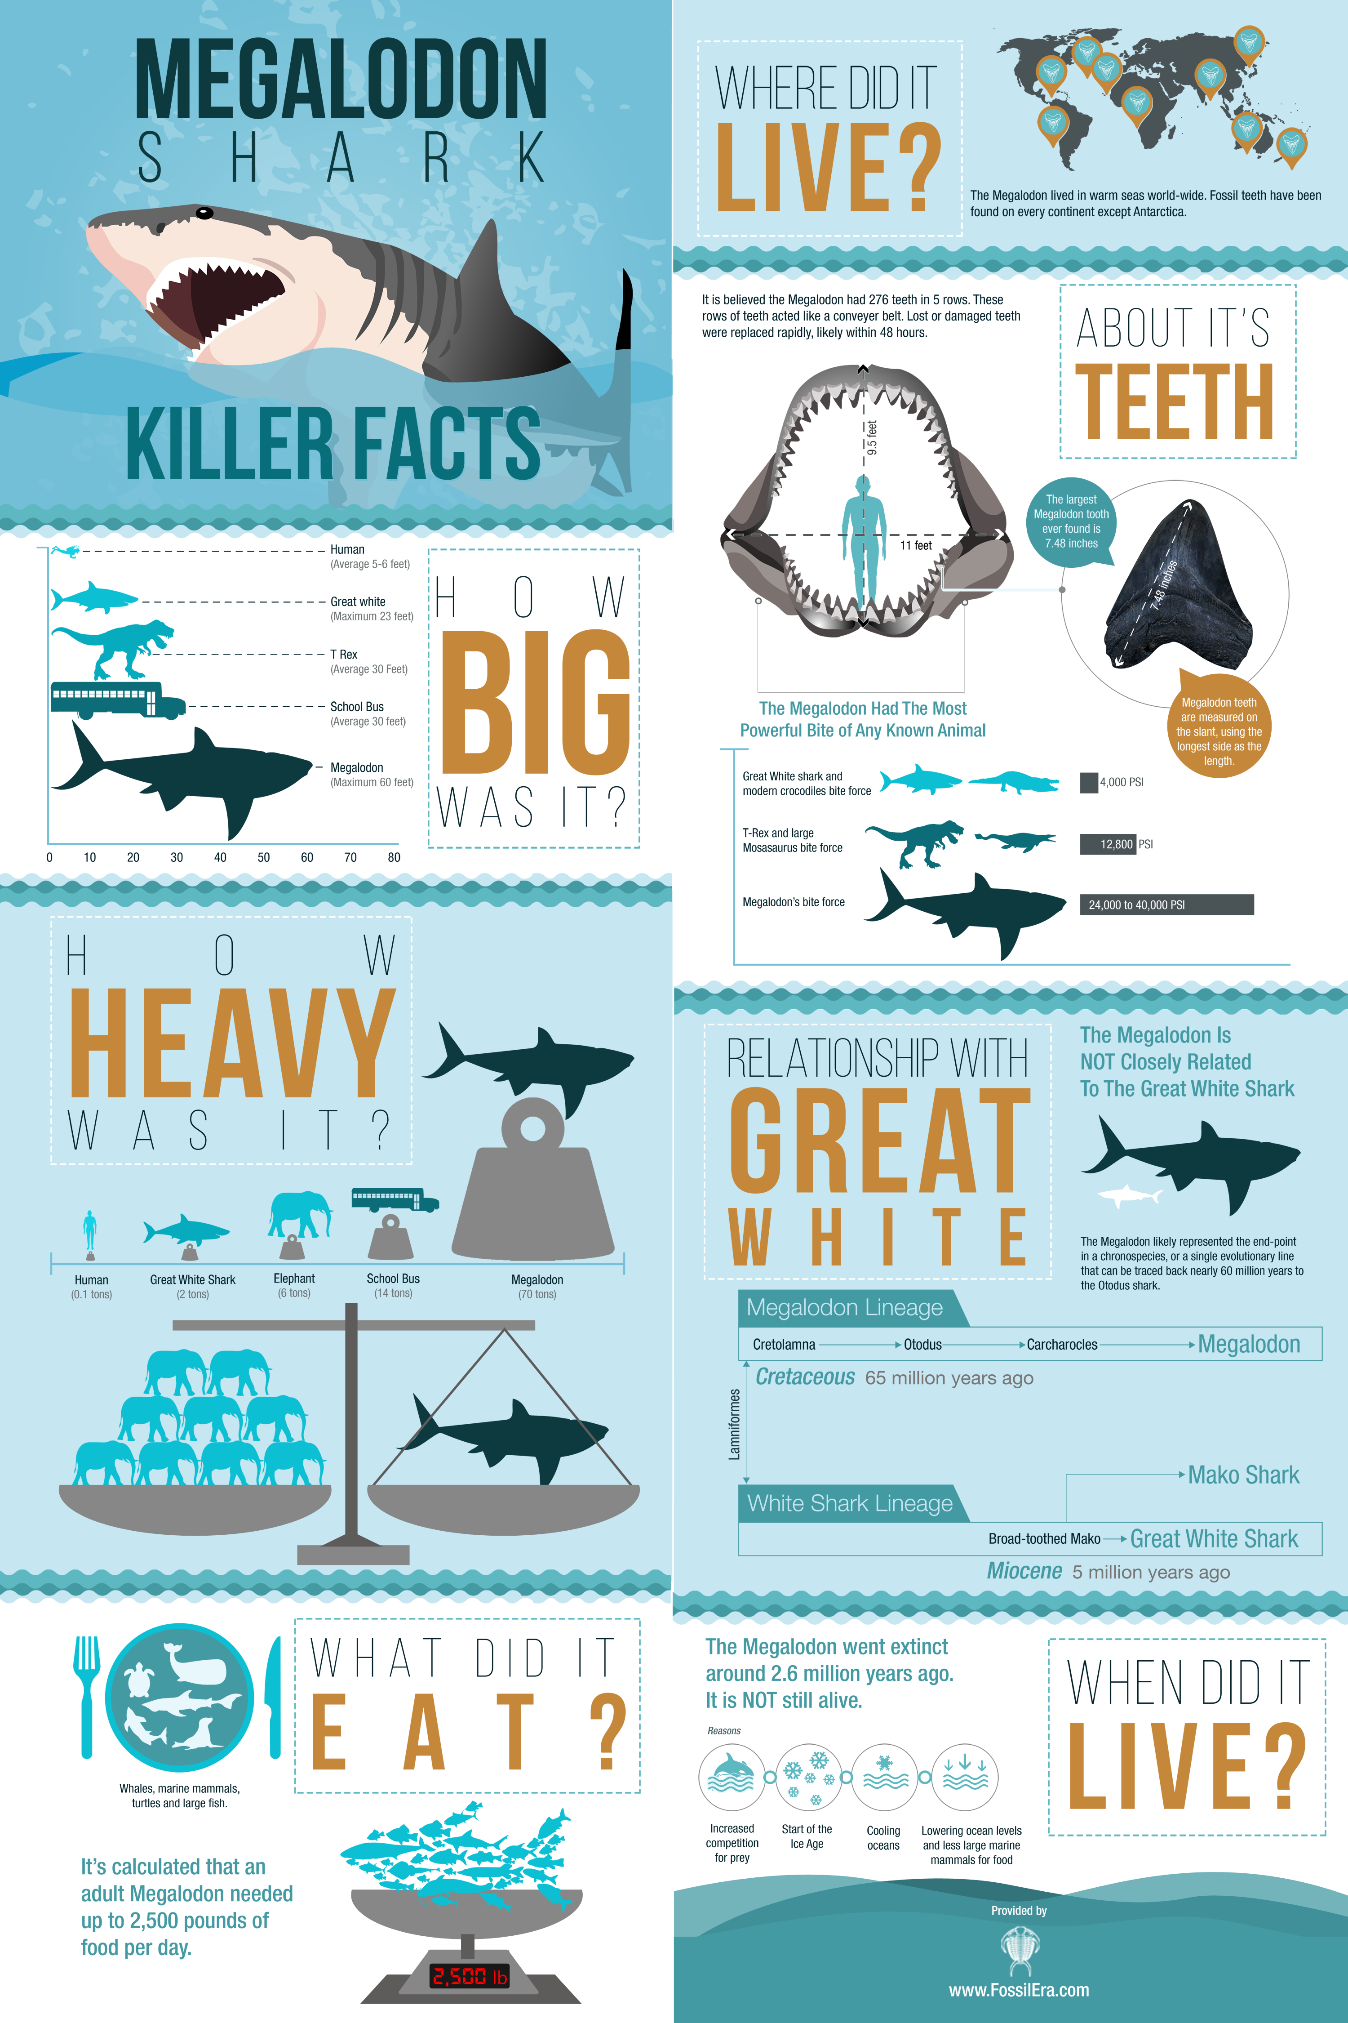
Posters
Posters also provide information. They might advertise a product, movie, event or company, give information about a topic, provide instructions. Sometimes their purpose is just to look awesome on your bedroom wall!
This Photo by Unknown Author is licensed under CC BY-SA
Notes:
If you made a poster, what would it be about? ? What is its purpose?

Slide 4
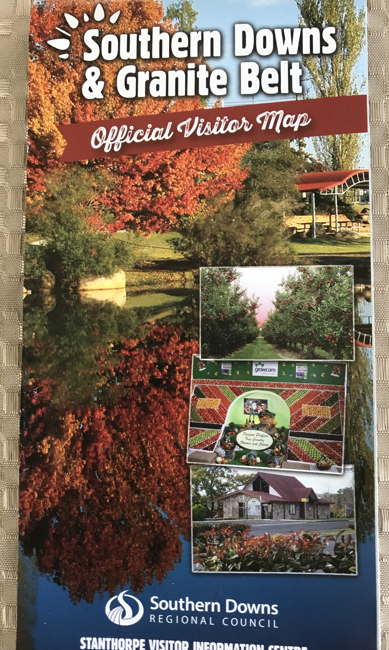
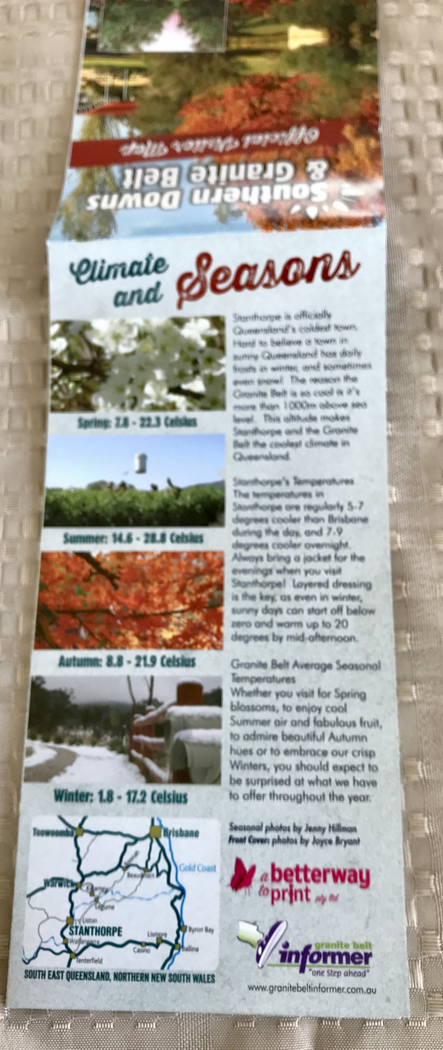
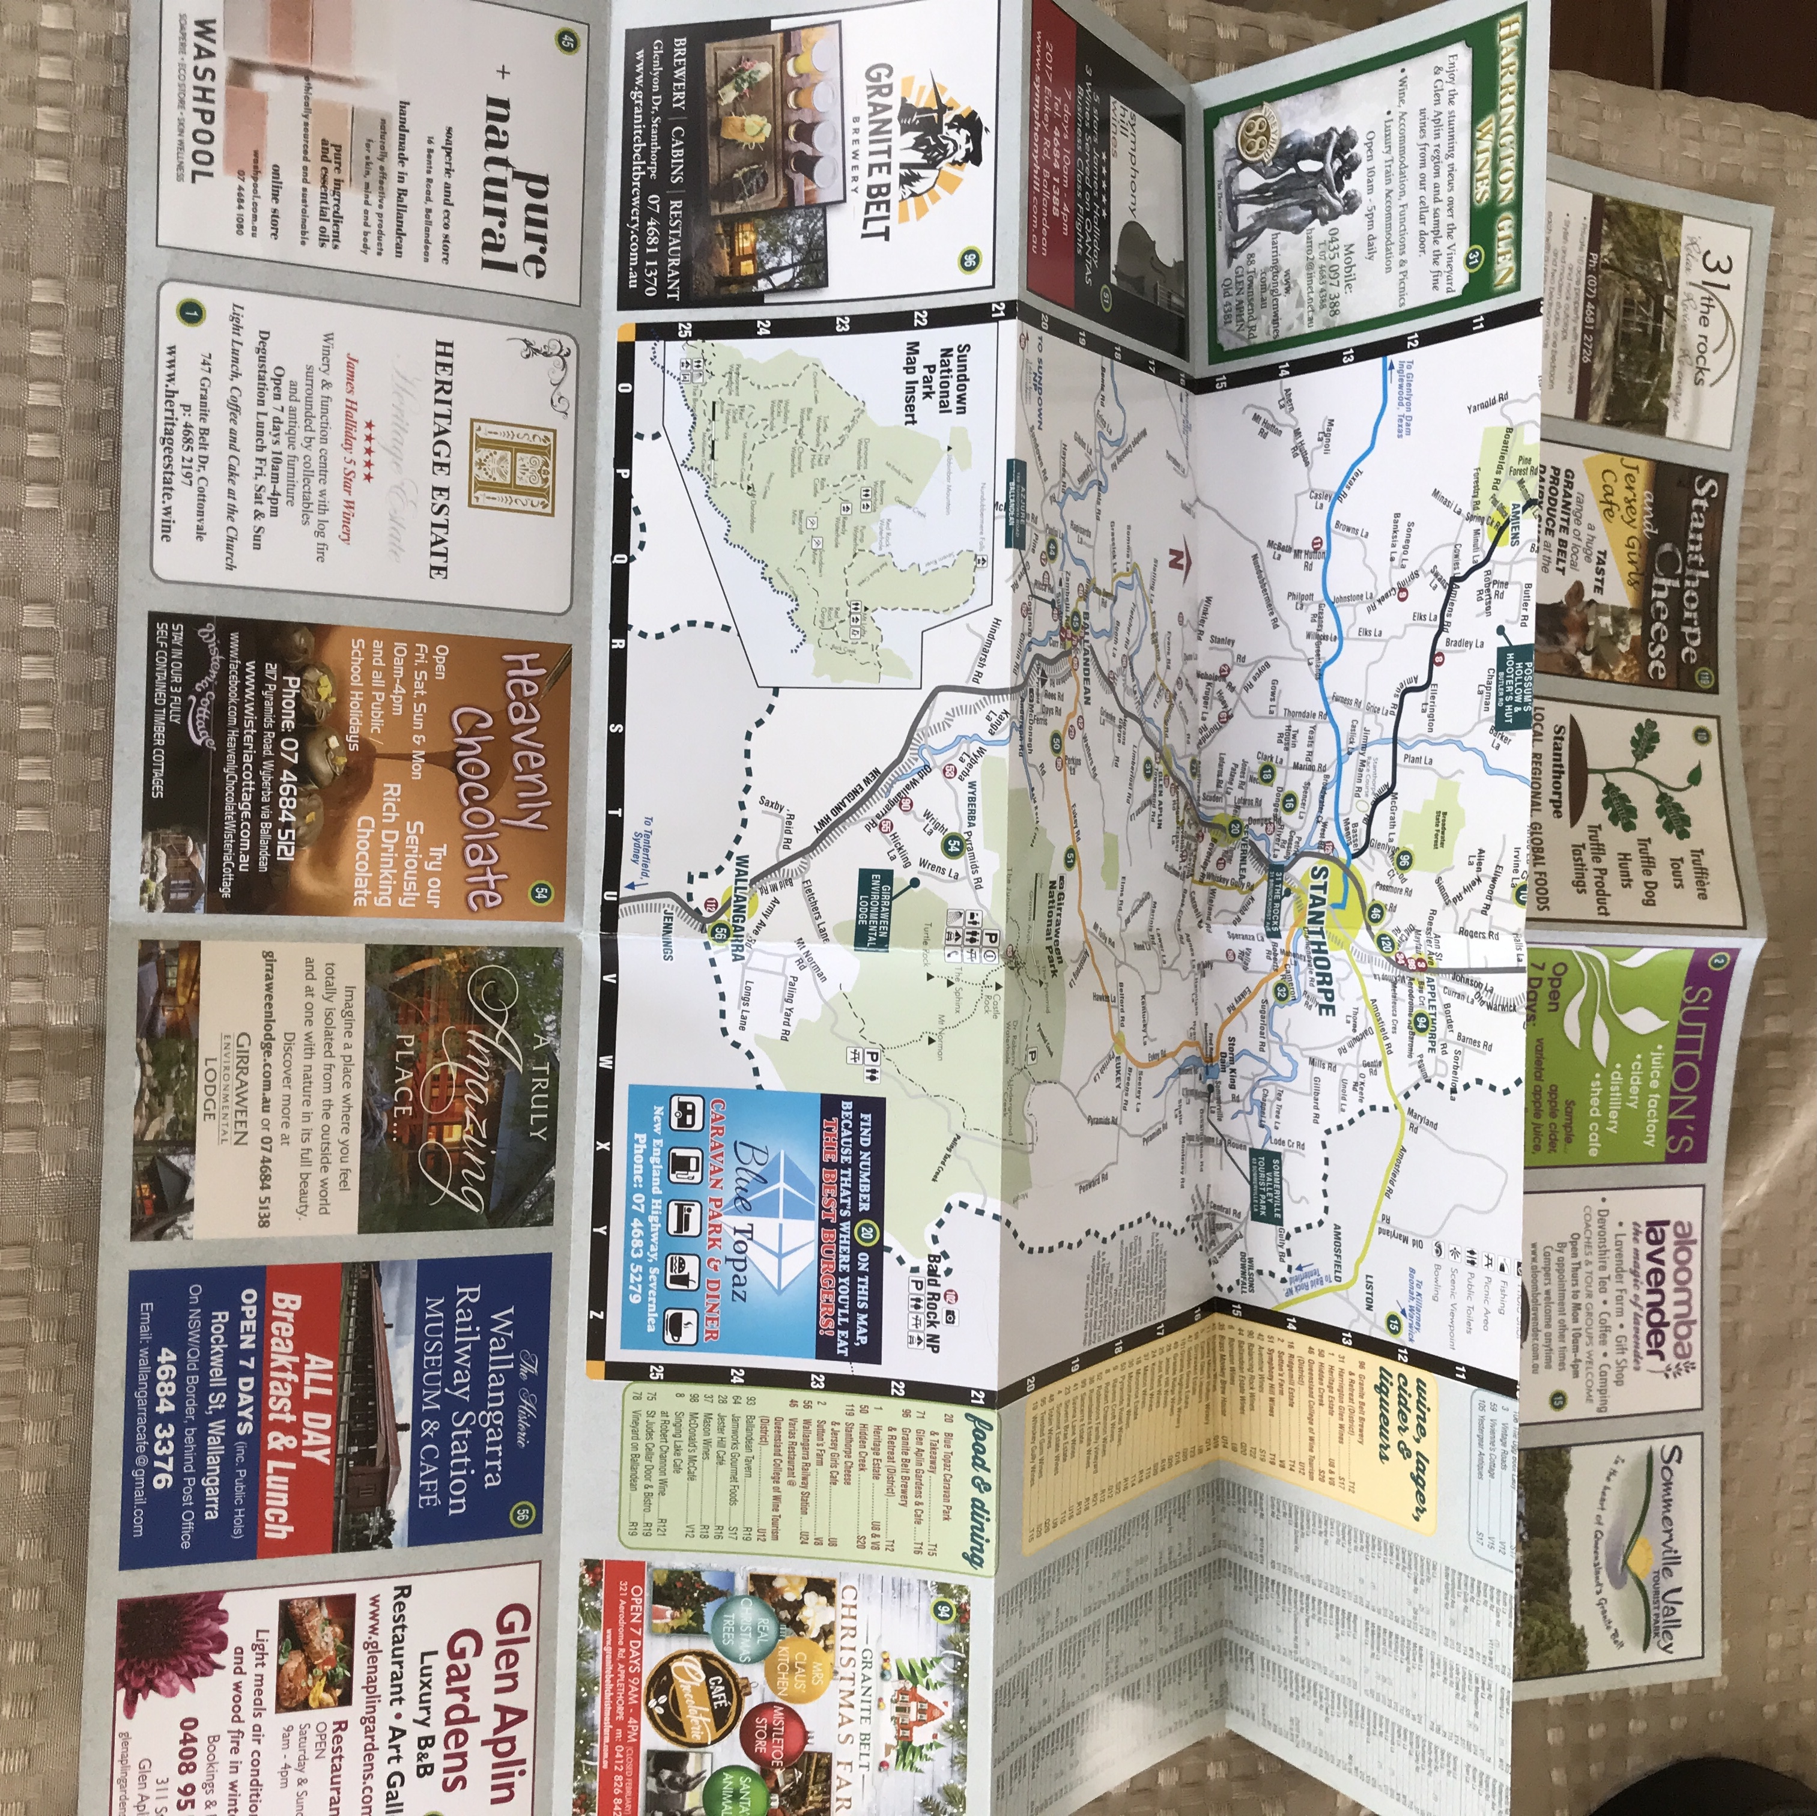
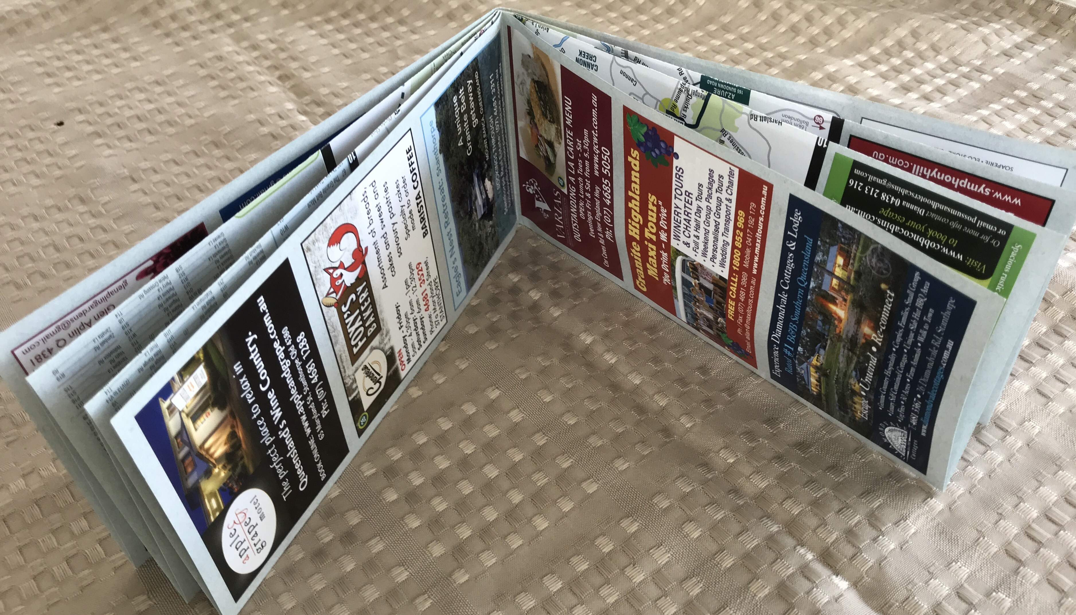
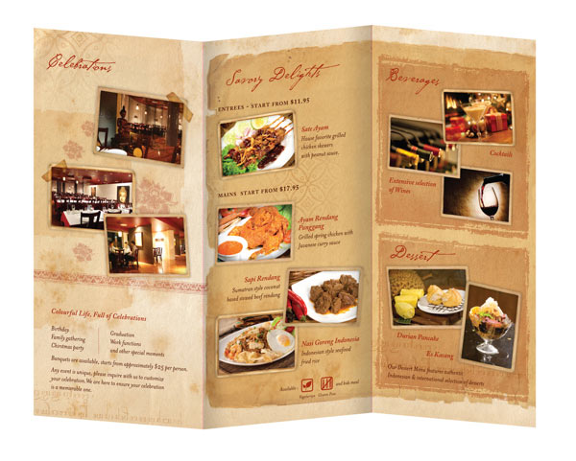
Brochures
Brochures inform, and sometimes persuade!
They can present a lot of information on both sides of the folded page.
Brochures deepen the reader’s understanding of a topic by text, photographs, and even diagrams and maps!
They are a great text type for providing a lot of information on places to visit.
Notes:
If you made a brochure, what would it be about? What is its purpose?

Slide 5
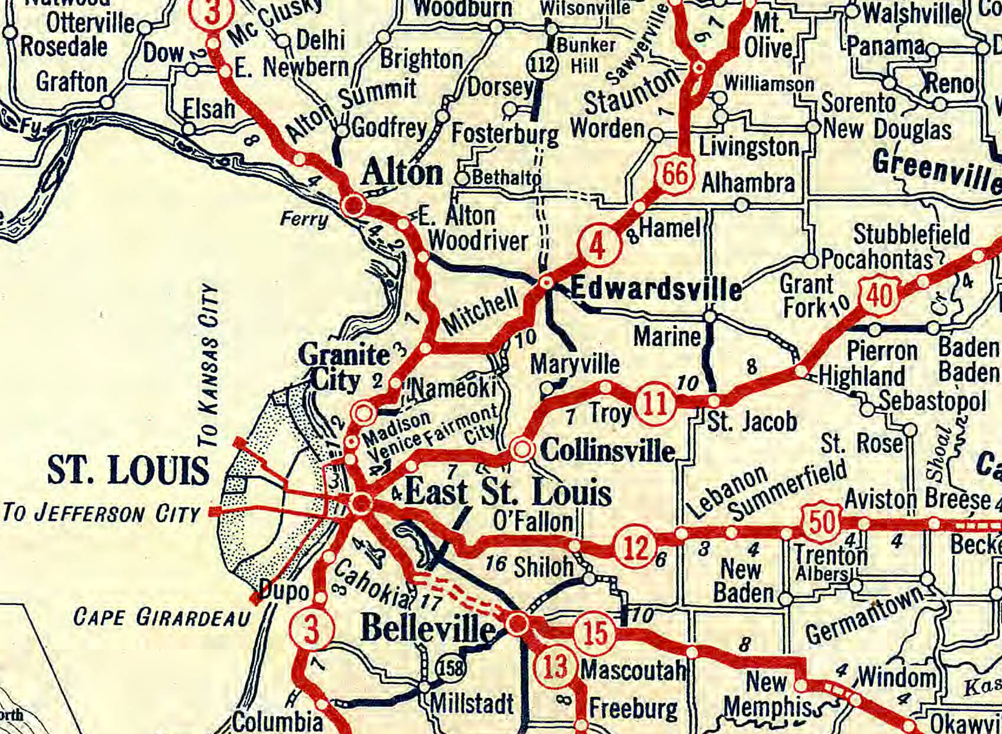
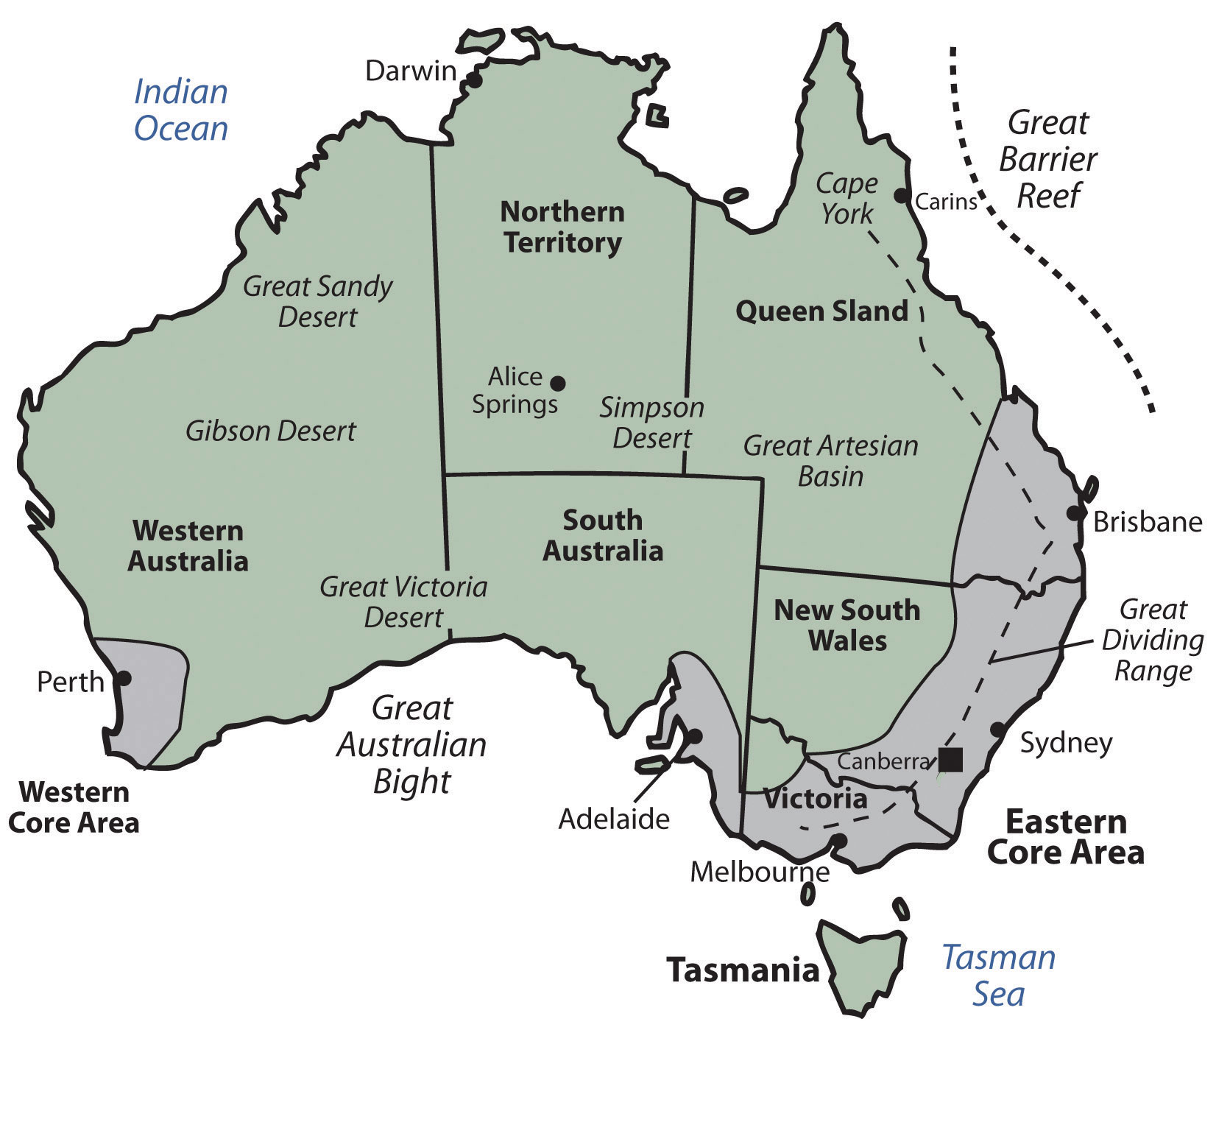
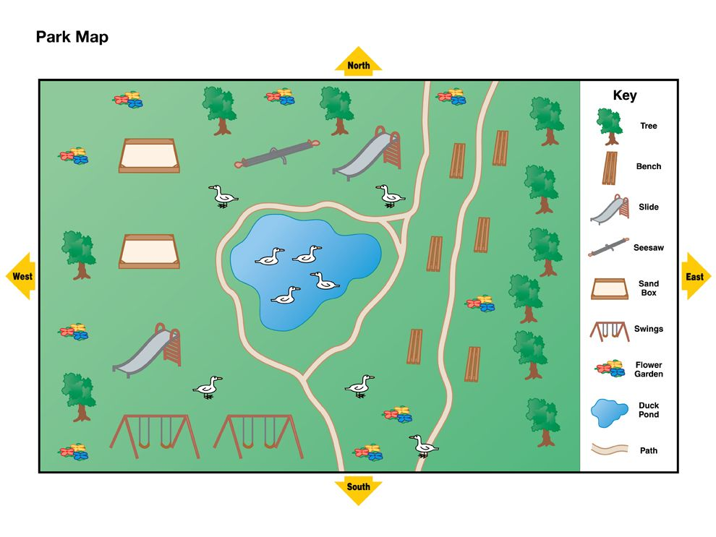
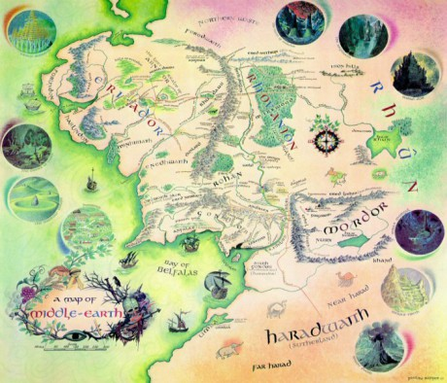
Maps
Maps give information about where places are located!
Maps show direction, size and distance using special text tools and symbols.
We learn to “read” maps by understanding the special text tools and symbols they use!
This Photo by Unknown Author is licensed under CC BY-SA
Maps represent the real world on a much smaller scale. They help you travel from one location to another. They help you organise information. They help you figure out where you are and how to get where you want to go.
This Photo by Unknown Author is licensed under CC BY
Notes:
If you made a brochure, what would it be about? What is its purpose?

